Slide 1
Parts Inventory Sheets
EV3

Slide 2
Inventory Sheet #1

Slide 3
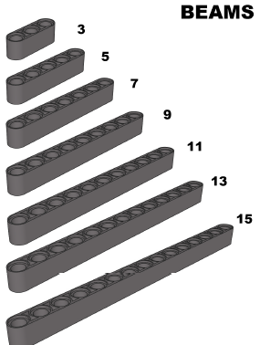
BEAMS

Slide 4
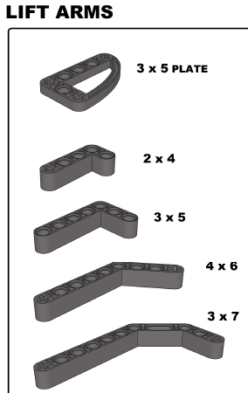
Lift Arms

Slide 5
Wheels (4)

Slide 6
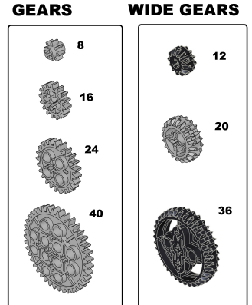
Gears

Slide 7
Inventory Sheet #2

Slide 8

BEAM JOINERS (6)

Slide 9
L-SHAPED BEAM JOINERS (4)

Slide 10
TRIANGLE BEAM (4)

Slide 11
½ BEAM 4 MODULE (2)

Slide 12
CROSS BLOCK FORK (4)

Slide 13
CONNECTOR PEG WITH HANDLE (2)

Slide 14
DOUBLE CONNECTOR PEG (4)

Slide 15
DOUBLE CROSS BLOCK (8)

Slide 16
CROSS BLOCK (8)

Slide 17
CROSS BLOCK 3X2-MODULE (6)

Slide 18
CROSS BLOCK 2X2-MODULE (4)

Slide 19
CROSS BLOCK 2-MODULE (8)

Slide 20
ANGULAR BLOCK 0 ⁰ (4)

Slide 21
3-SPOKE ANGULAR BLOCK (2)

Slide 22
CROSS BEAM (2)

Slide 23
ANGULAR BLOCK 90⁰ (2)

Slide 24
BUSHING/AXLE EXTENDER (6)

Slide 25
BEAM 3-MODULE (16)

Slide 26
POINTER (4)

Slide 27
BEAM WITH CROSSHOLE (4)

Slide 28
RUBBER BEAM WITH CROSSHOLES (4)

Slide 29
BEAM 3-MODULE BLACK (2)

Slide 30
INVENTORY SHEET #3

Slide 31
AXLE 2-MODULE (10)

Slide 32
AXLE 4-MODULE (4)

Slide 33
AXLE 4-MODULE (4)

Slide 34
AXLE 5-MODULE (5)

Slide 35
AXLE 6-MODULE (4)

Slide 36
AXLE 7-MODULE (5)

Slide 37
AXLE 8-MODULE (2)

Slide 38
AXLE 9-MODULE (2)

Slide 39
AXLE 10-MODULE (2)

Slide 40
AXLE 12-MODULE (2)

Slide 41
CONNECTOR PEG WITH AXLE 2-MODULE (8)

Slide 42
BUSHING 1-MODULE (10)

Slide 43
CONNECTOR PEG 3-MODULE (6)

Slide 44
AXLE WITH STOP 8-MODULE (2)

Slide 45
AXLE WITH STOP 4-MODULE (2)

Slide 46
AXLE WITH STOP 3-MODULE (2)

Slide 47
TUBE 2-MODULE (4)

Slide 48
FRAME 5X11-MODULE (1)

Slide 49
STEEL BALL (1) BALL BEARING (1)

Slide 50
FRAME 5X7 -MODULE (3)

Slide 51
INVENTORY SHEET #4

Slide 52
EV3 BRICK (1)

Slide 53
LARGE MOTOR (2)

Slide 54
MEDIUM MOTOR (1)

Slide 55
SPROCKET (4)

Slide 56
RIGHT CURVED PANEL 3X5 (1)

Slide 57
LEFT CURVED PANEL 3X5 (1)

Slide 58
LEFT CURVED PANEL 5X11 (1)

Slide 59
RIGHT CURVED PANEL 5X11 (1)

Slide 60
ULTRASONIC SENSOR (1)

Slide 61
GYRO SENSOR (1)

Slide 62
LIGHT SENSOR (1)

Slide 63
TOUCH SENSOR (2)

Slide 64
HUB AND TIRE (2)

